Slide 1
DEEP LEARNING
Unit – 1
Prof M S Srividya
Assistant Professor,
Computer Science and Engineering
RV College of Engineering
Bengaluru – 59

Slide 2
Data Augmentation
Data augmentation techniques generate different versions of a real dataset artificially to increase its size
Computer vision and natural language processing (NLP) models use data augmentation strategy to handle with data scarcity and insufficient data diversity
Data augmentation algorithms can increase accuracy of machine learning models

Slide 3
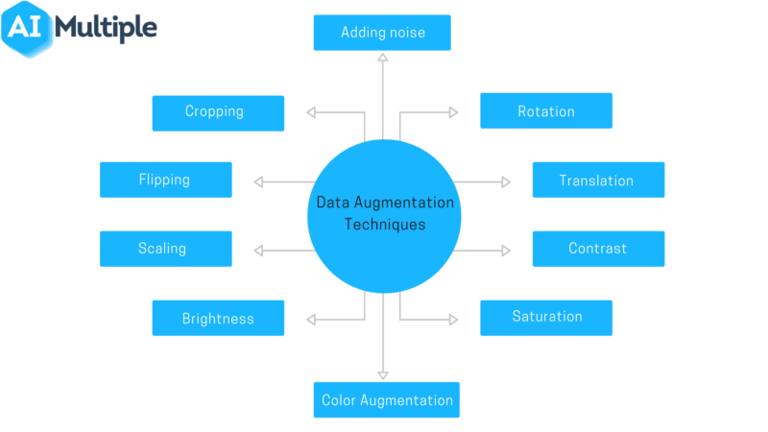
Data Augmentation

Slide 4
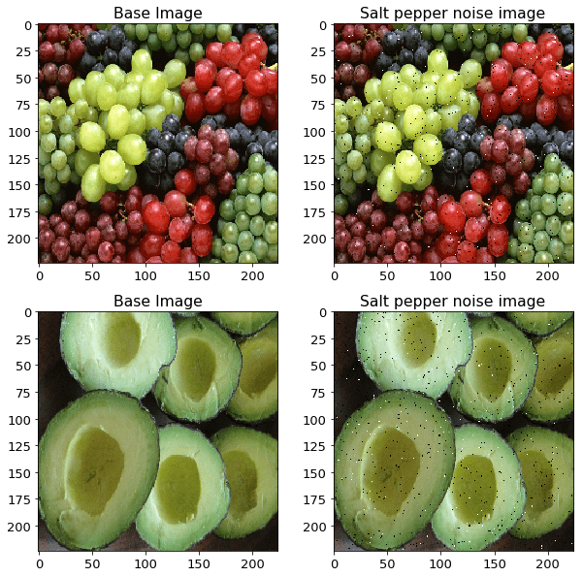
Data Augmentation
Adding noise
For blurry images, adding noise on the image can be useful.
By “salt and pepper noise”, the image looks like consisting of white and black dots.

Slide 5
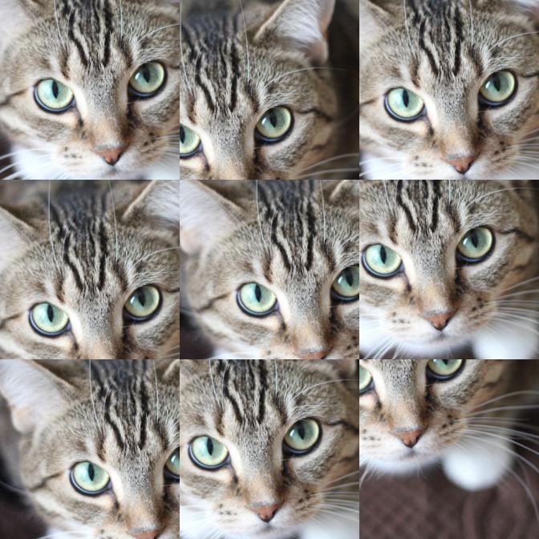
Data Augmentation
Cropping
A section of the image is selected, cropped and then resized to the original image size.

Slide 6
Data Augmentation
Flipping
The image is flipped horizontally and vertically.
Flipping rearranges the pixels while protecting the features of the image.
Vertical flipping is not meaningful for some photos, but it can be useful in cosmology or for microscopic photos.
1:ORIGINAL IMAGE – 2. HORIZONTAL FLIP – 3.VERTICAL FLIP

Slide 7
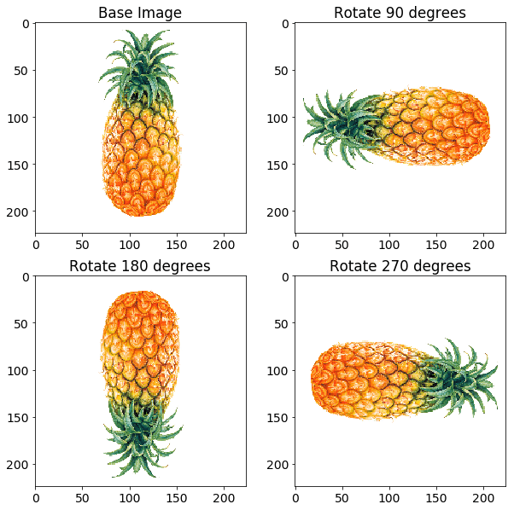
Data Augmentation
Rotation- The image is rotated by a degree between 0 and 360 degree. Every rotated image will be unique in the model.

Slide 8
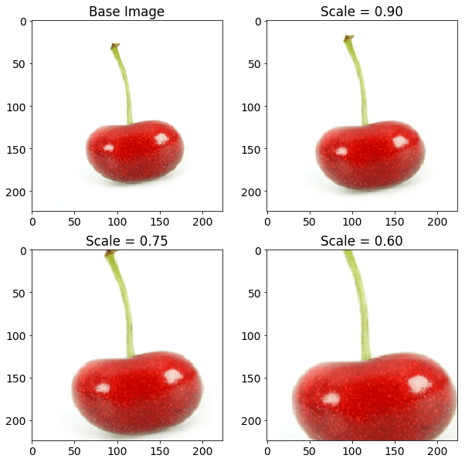
Data Augmentation
Scaling- The image is scaled outward and inward. An object in new image can be smaller or bigger than in the original image by scaling.

Slide 9

Data Augmentation
Translation- The image is shifted into various areas along the x-axis or y-axis, so neural network looks everywhere in the image to capture it.

Slide 10
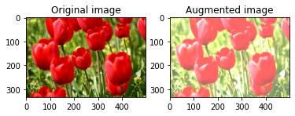
Data Augmentation
Brightness- The brightness of the image is changed and new image will be darker or lighter. This technique allows the model to recognize image in different lighting levels.

Slide 11
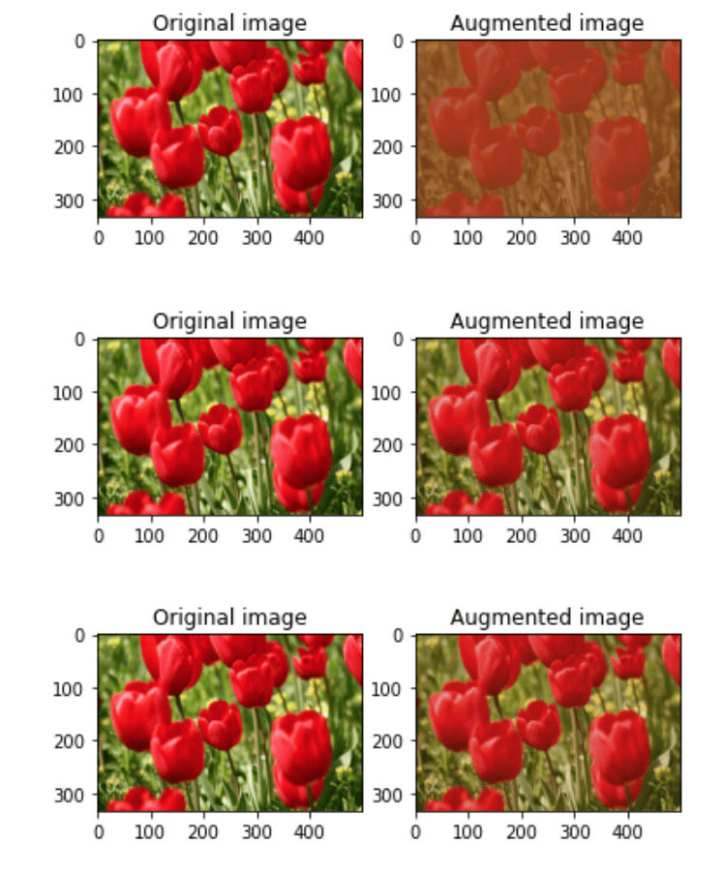
Data Augmentation
Contrast- The contrast of the image is changed and new image will be different from luminance and colour aspects. The following image’s contrast is changed randomly.

Slide 12
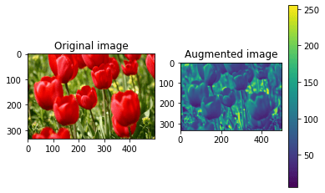
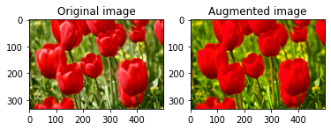
Color Augmentation
The color of image is changed by new pixel values.
Saturation is depth or intensity of color in an image.

Slide 13
Data augmentation techniques in NLP models
Data augmentation techniques are applied on character, word and text levels
Easy Data Augmentation (EDA) Methods - include easy text transformations,
Example a word is chosen randomly from the sentence and replaced with one of this word synonyms or two words are chosen and swapped in the sentence.
EDA techniques examples in NLP processing are
Synonym replacement
Text Substitution (rule-based, ML-based, mask-based and etc.)
Random insertion
Random swap
Random deletion
Word & sentence shuffling

Slide 14
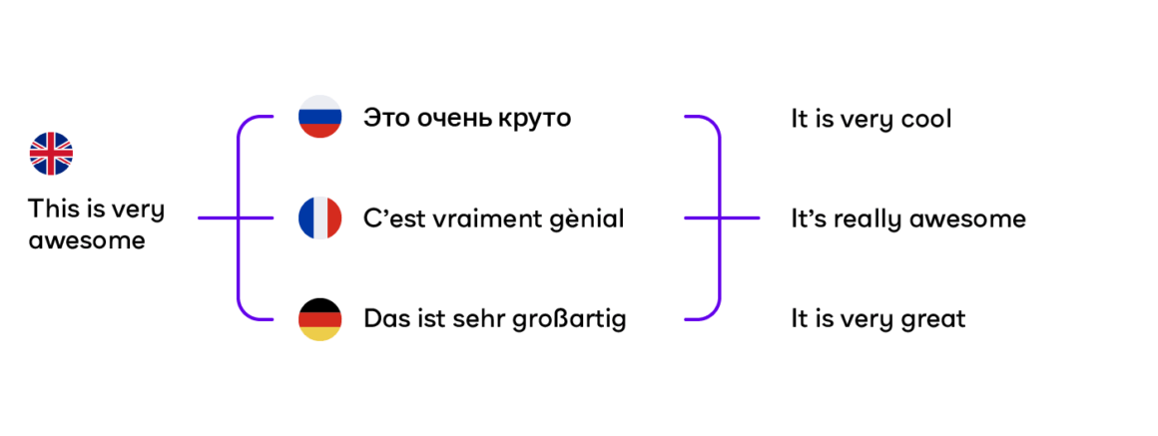
Data Augmentation
Back Translation- A sentence is translated in one language and then new sentence is translated again in the original language. So, different sentences are created.

Slide 15
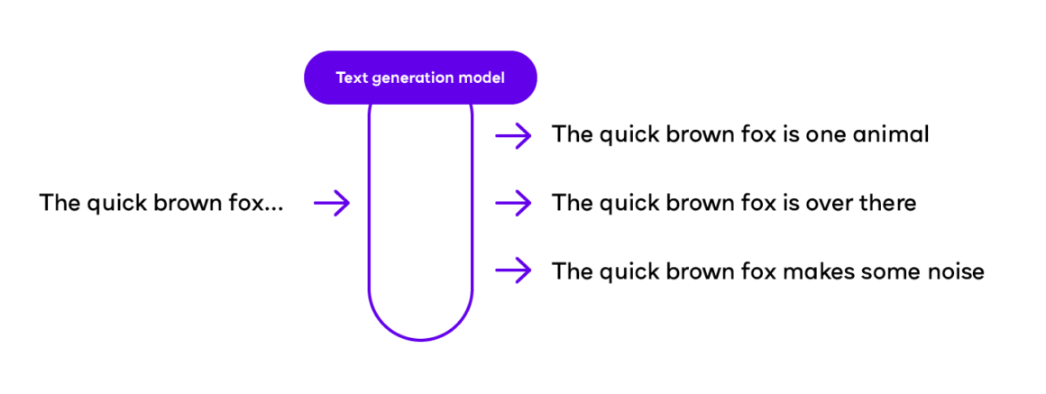
Data Augmentation
Text Generation- A generative adversarial networks (GAN) is trained to generate text with a few words.

Slide 16
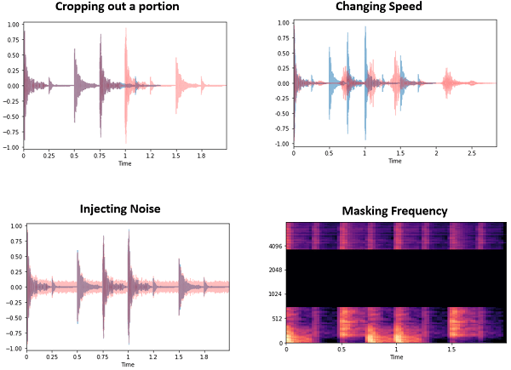
Data augmentation techniques for audio data
Audio data augmentation methods include
→Cropping out a portion of data, -→Noise injection,
→Shifting time,
→Speed tuning
→Changing pitch,
→Mixing background noise →Masking frequency

Slide 17
Regularization
Regularization is a technique which makes slight modifications to the learning algorithm such that the model generalizes better.
Improves the model's performance on the unseen data as well.

Slide 18
Regularization Techniques in Deep Learning
L2 & L1 regularization
These update the general cost function by adding another term known as the regularization term.
Cost function = Loss (say, binary cross entropy) + Regularization term
It will also reduce overfitting to quite an extent.
The regularization term differs in L1 and L2.

Slide 19


Regularization Techniques in Deep Learning
In L2, we have:
→lambda is the regularization parameter.
→It is the hyperparameter whose value is optimized for better results
→L2 regularization is also known as weight decay as it forces the weights to decay towards zero (but not exactly zero).
In L1, we have:
Penalize the absolute value of the weights.
Unlike L2, the weights may be reduced to zero here.
Hence, it is very useful when we are trying to compress our model. Otherwise, we usually prefer L2 over it.

Slide 20
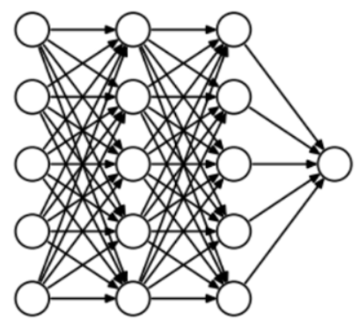
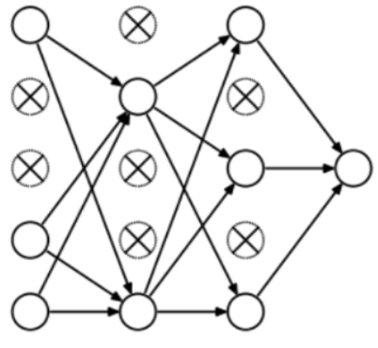
Regularization Techniques
Dropout
→Most frequently used regularization technique
→At every iteration, it randomly selects some nodes and removes them along with all of their incoming and outgoing connections

Slide 21

Thank You

